Slide 1
E-commerce Website Logs.csv
CAPSTONE PROJECT
Presented By:
Name: Azeez Mohammed
Institute: Aurora's Technological and Research Institute
Branch: Electrical and Electronic Engineering
Year: 4-2
AICTE Student ID: STU65b74859eacfb1706510425
Internship ID: INTERNSHIP_17014232196569a8736a0de
Gmail ID: azeezmd9390@gmail.com
Phone.no: 9390355963

Slide 2
OUTLINE
Problem Statement (Should not include solution)
Proposed System/Solution
System Development Approach (Technology Used)
Algorithm & Deployment
Result
Conclusion
Future Scope
References

Slide 3
Problem Statement
E-commerce website logs data created for helping the data analysts to practice exploratory data analysis and data visualization. The dataset has data on when the website was accessed, IP address of the source, Country, language in which website was accessed, amount of sales made by that country.

Slide 4
Proposed Solution
Data Collection: This involves gathering the necessary e-commerce website logs that will be used for prediction. This could be user activity logs, transaction logs, error logs, etc.
Data Preprocessing: The raw logs need to be cleaned and transformed into a format suitable for analysis. This could involve handling missing values, removing outliers, encoding categorical variables, etc.
Feature Engineering: This involves creating predictive features from the preprocessed data. The features could be based on user behavior patterns, time series trends, etc.
Model Building: Use data analytics and Python techniques to build a predictive model. This could involve splitting the data into training and test sets, selecting a suitable algorithm, training the model, and tuning its parameters.
Model Evaluation: Assess the performance of the model using appropriate metrics and validation techniques. This could involve computing metrics like accuracy, precision, recall, F1 score, etc., and using techniques like cross-validation.
Prediction: Use the trained model to make predictions on new, unseen data.
System Integration: Integrate the prediction model into the existing e-commerce system so that it can use the predictions in real-time.

Slide 5
System Approach
System Requirements:
Hardware Requirements: Detail the necessary hardware components (like servers, computers, etc.) needed to run the system.
Software Requirements: List the operating systems, programming languages, databases, and other software that the system will use.
Library Required to Build the Model: Discuss the specific libraries and packages that will be used in the development of the prediction model. For example, if you’re using Python, you might mention libraries like pandas for data manipulation, NumPy for numerical computations, and scikit-learn for machine learning.
Data Collection and Preprocessing: Describe how you’ll collect and preprocess the website logs for the prediction model. This could include data cleaning, normalization, handling missing values, etc.
Model Development: Explain the algorithms or methods you’ll use to develop the prediction model. Discuss why you chose these methods and how they’ll help achieve your goals.
Model Testing and Validation: Outline how you’ll test the prediction model to ensure it’s working as expected. This could include cross-validation, performance metrics, etc.
System Implementation: Discuss how the prediction model will be implemented into the existing system. This could include details about system integration, user interface design, etc.
Maintenance and Updates: Explain how the system will be maintained and updated over time to ensure its continued effectiveness.

Slide 6
Algorithm & Deployment
Algorithm Analysis: The analyst is responsible for designing and evaluating algorithms. They need to understand the computational complexity of algorithms and how the running time or space used by an algorithm grows with the size of the input..
Deployment Analysis: The analyst develops strategies to optimize the deployment of new technologies in an organization, ensuring a smooth and efficient workflow. They conduct research and analyses, gather and interpret data from different departments, conduct risk assessments, create business forecasts and sales models, and develop business plans according to the company’s vision and mission.
System Integration: The analyst is also responsible for integrating the developed algorithms into the existing system. They might install new computer systems, troubleshoot problems, administer and support software, and design packages.
Performance Monitoring: Post-deployment, the analyst monitors the performance of the algorithms and systems, ensuring they are working as expected and meeting the set Key Performance Indicators (KPIs)².
Maintenance and Updates: The analyst maintains and updates the system based on user feedback and changing requirements.

Slide 7
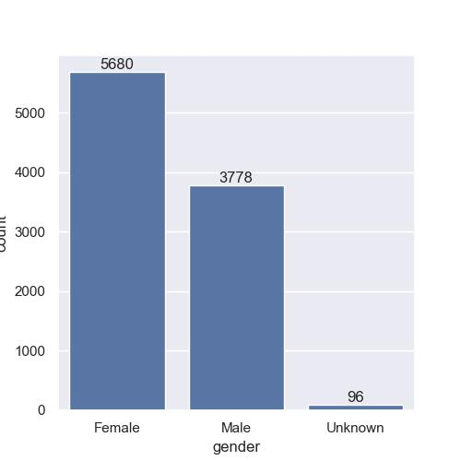
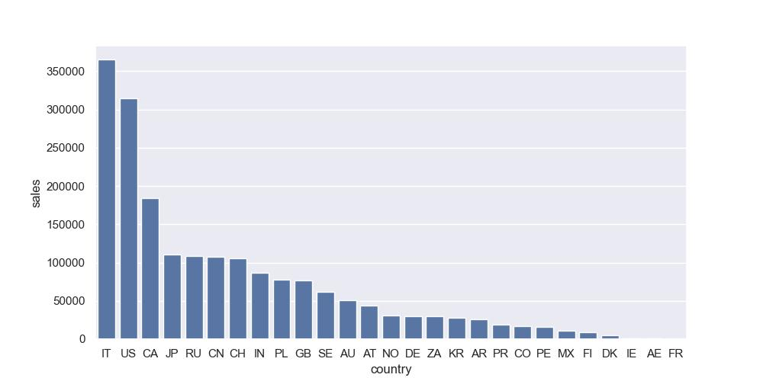
Result

Slide 8
Conclusion
In conclusion, the E-commerce website logs dataset provides a rich source of information for data analysts. It allows them to practice and enhance their skills in exploratory data analysis and data visualization. The dataset includes crucial data points such as the time of website access, source IP address, country of access, language used, and sales made by that country.
Analyzing this data can offer valuable insights into user behavior, sales trends, and potential areas for business growth. For instance, understanding the peak times of website access can help in server management and improving user experience. Similarly, analyzing sales by country can aid in market segmentation and targeted marketing.
Therefore, this dataset not only serves as a practical tool for learning data analysis techniques but also simulates real-world data challenges that analysts might face in the E-commerce industry. It underscores the importance of data-driven decision-making in enhancing business performance and customer satisfaction

Slide 9
Future scope
The future scope of using E-commerce website logs for data analysis and visualization is vast and promising. Here are some potential directions:
Advanced Predictive Analytics: With the growth of machine learning and artificial intelligence, there’s a significant potential to develop more sophisticated predictive models. These could forecast future sales trends, predict customer behavior, or even detect fraudulent activities.
Real-Time Analytics: As technology advances, there’s an increasing demand for real-time analytics. This involves analyzing website logs as they are generated to provide instant insights, which can be crucial for timely decision-making.
Personalization: The data from website logs can be used to understand individual user behavior better, leading to more personalized user experiences. This could involve personalized product recommendations, dynamic pricing, or personalized marketing.
Multilingual Analysis: As e-commerce becomes more global, there’s a need to cater to customers who speak different languages. Analyzing the language in which the website was accessed can provide insights into this aspect.
Integration with Other Data Sources: Website logs can be combined with other data sources like customer demographics, social media data, etc., for a more holistic view of the business.
Improving User Experience: By understanding when and how users access the website, businesses can optimize the user experience, leading to higher customer satisfaction and increased sales.

Slide 10
References
https://www.kaggie.com/datasets
https://pandas.pydata.org/pandas-docs/stable/user_guide/index.html
https://seaborn.pydata.org/
https://matplotlib.org/stable/contents.html
e-commerce website logs(https://kaggle.com)

Slide 11

course certificate 1

Slide 12

course certificate 2

Slide 13

Course Certificate 3

Slide 14
THANK YOU

